Slide 1
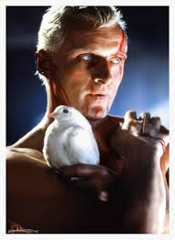
Film Studies: Lighting
The light that burns twice as bright burns half as long. And you have burned so very, very brightly, Roy

Slide 2
Blade Runner
Blade Runner is a Science Fiction Noir directed by Ridley Scott and released in 1982.
Ridley Scott managed to create a very strong identity and aesthetic for blade runner with exceptional use of the films Visual Composition This allows us, the audience, to derive meaning from the films visual elements. The setting, costumes and lighting of Blade Runner are deeply intertwined with its plot and themes.
Blade Runner revolves around the themes of dehumanization of people resulting from a society based around high technology and the notion of what it means to exist as a human being. The mise-en-scene of Blade Runner is not only appropriate to its overriding themes but it is vital in the establishment and expansion of these themes within the text.
Blade Runner can be looked at as having two overarching themes. The film depicts a society in which the proliferation and excess of high technology serves as a dehumanizing force. Within this environment in which human life no longer seems to be of utmost importance the question of what exactly it means to be human is entrenched within the film text.

Slide 3
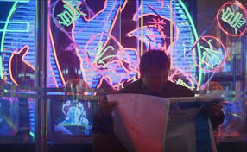
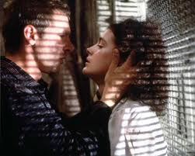
Lighting
In the construction of film and television narratives much energy and expense is devoted to making most scenes look natural, that is how we would imagine it would look in real life. This is called naturalistic lighting.
Expressive lighting is a style of lighting used to represent greater meaning in relation to characters, settings, mood and themes. Example- a character is lit from behind making them glow, perhaps they are the angel that will save the situation. When a character is lit from below they may appear aggressive.

Slide 4
Film Studies: Lighting
Lighting not only allows an audience to see the action in a film, it shapes and frames this action drawing attention to objects characters and actions thus illuminating far more than what is on the screen.
The colour and quality of the light positions the audience to read the shot or scene in a particular way.
Lighting works both literally and symbolically employing both visual codes and conventions to suggest interpretation
There are five primary types of directional lighting: frontal lighting, side lighting, back lighting, under lighting, and top lighting

Slide 5
Lighting Position
Lighting in Blade Runner
Frontal lighting is where the light source is directly behind the viewer's point of view. Front lighting does little to reveal form or texture since the shadows are mostly hidden from view; as a result it can make things look flat. However soft diffused frontal lighting can also be quite flattering to some subjects for this very reason
Side Lighting is very good for showing form and texture and lends a three-dimensional quality to objects. Shadows are prominent and contrast can be high as a result. Side lighting can be used to throw dramatic shadows onto surfaces such as walls and create atmosphere.

Slide 6
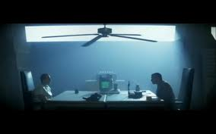
Lighting Position
Backlighting is where the viewer is looking into the light source, and objects will have their lit sides facing away from us to appear either as silhouettes or darkly lit by the fill light. It is usually a high contrast situation and can often look very atmospheric and dramatic.
Top Lighting is often used to provide fill to other light sources. Independently as soft light it is an effective way of showing form. Under hard light it can lend an air of mystery by casting dramatic shadows which conceal most of the forms beneath them:

Slide 7
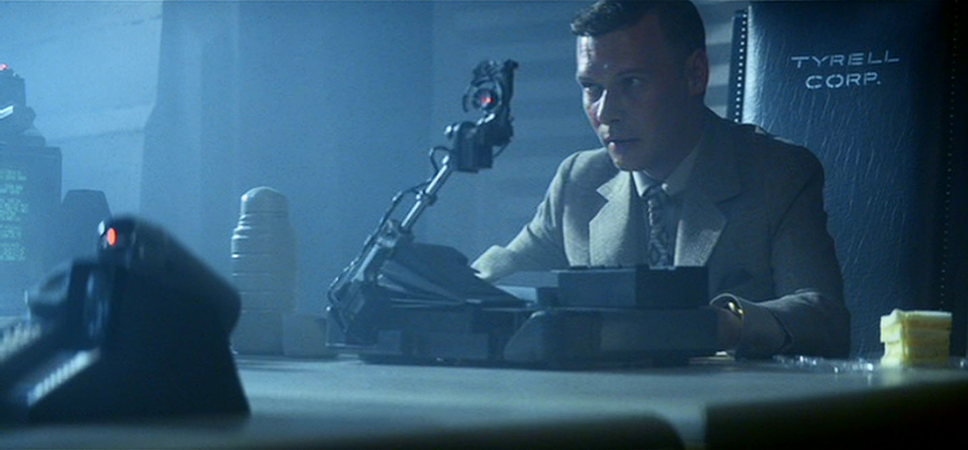
Lighting Position
Under Lighting suggests that the light comes from below the subject. Under lighting tends to distort features and is often used to create dramatic horror effects
Tinted Light is created by filters during production to color a scene for dramatic effect. In the scene where Holden interrogates Roy grey filtered light is used to accent the films dull metal color scheme and postindustrial look

Slide 8
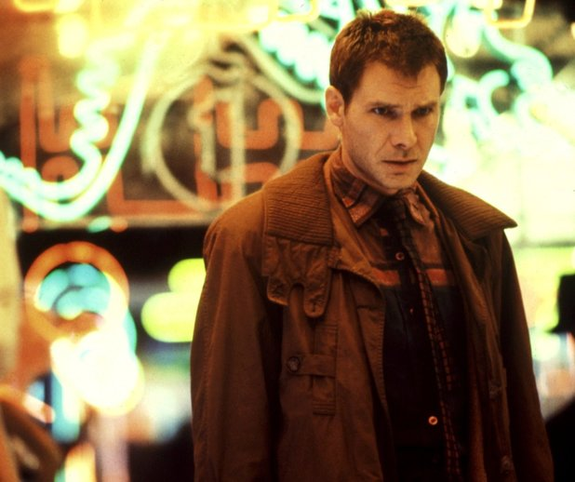
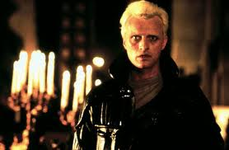
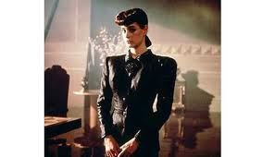
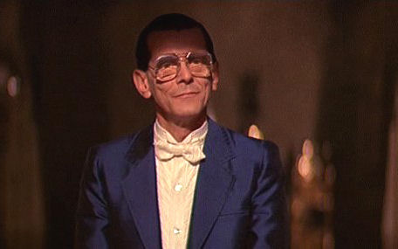
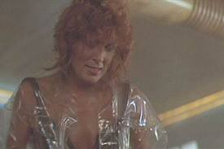
Lighting

Slide 9
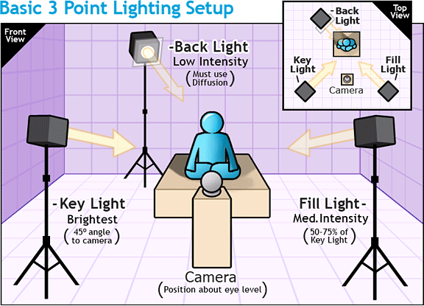
Lighting
Classical Hollywood filmmaking developed the custom of using at least three light sources per shot:
Key light: comes diagonally from the front
Fill light: from a position near the camera
Backlight from behind and above the figure

Slide 10
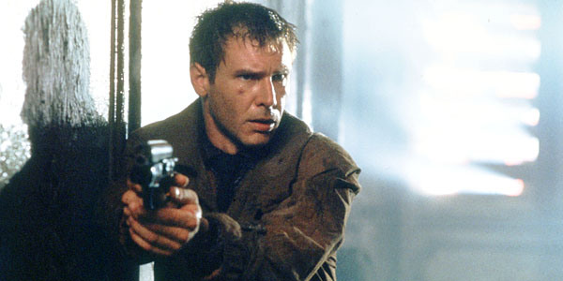
Lighting
BACK
LIGHT
FILLER LIGHTS
KEY LIGHT

Slide 11
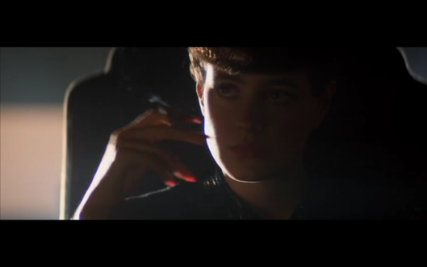
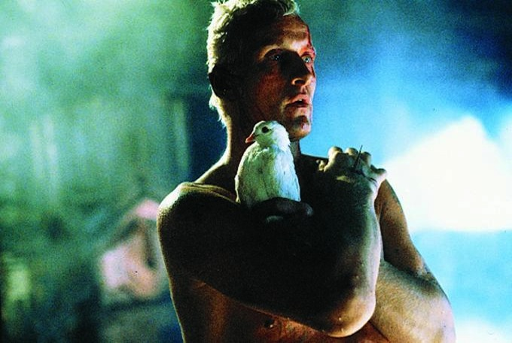
Lighting
LOW KEY LIGHTING
Creates stronger contrasts and sharper darker shadows
Often the lighting is hard and fill lights are eliminated all together
Deep, distinct shadows/silhouettes are formed

Slide 12
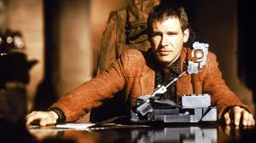
Lighting
HIGH KEY LIGHTING:
More filler lights are used. Lighting is natural and realistic to our eyes
Produces brightly lit sets or a sunny day (right)

Slide 13
Dark City, Dark People, Dark Times
From the first scenes in Blade Runner, the viewer can see that the film is dark, with very few bright or high lit shots.
There are stark contrasts between the neon lights and bright signs scattered through the futuristic L.A. setting and the darkened city streets, alleys, and buildings. The low lighting of this futuristic L.A. also makes the city feel dangerous.
This visual dynamic of the film helps relate the dark nature of the film itself. There are themes and characters with dark and mysterious roots woven throughout Blade Runner and the incredibly low key lighting seen throughout the film helps project this to viewers.

Slide 14
Lighting
Lighting in Film Noir
Film noir is characterised by a visual style in which dark and dangerous rain washed city streets provide the setting for crime and corruption
The lighting in film noir reflects its themes. Chiaroscuro low key lighting creates deep shadows in which characters can physically and metaphorically hide, their motivations and actions thus obscured
Lighting is the most distinctive feature of film noir with highly contrasted areas of light and shade. Dramatic patterns of light and shade are created by light filtering through a blind or a latticed window.

Slide 15
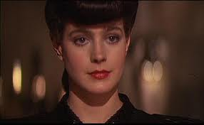
Lighting
Lighting in Film Noir
Lighting can evoke mood and atmosphere and contribute to relationships between characters.
One approach to answering a question on lighting is to Discuss the style and effect of the lighting in 2 sequences such as these when Deckard first meets Rachael whom at this time is confident that she is not a replicant. How does the variation in lighting reflect the character development of Rachael whilst she is being tested and perhaps begins to doubt her believe that she is human

Slide 16
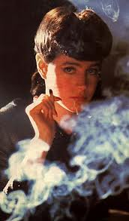
Film Noir Connection
The film is rooted in a futuristic version of the film noir
style. Film noir is traditionally shot with a low key lighting
approach to play up the mystery and suspense of the film.
The lighting scheme in Blade Runner helps achieve this
same mysterious and suspenseful feeling. Looking and feeling like a film noir piece assists Blade Runner’s story be conveyed to the viewer.
We accept and understand the “femme fatale” character of of Rachael and start to make assumptions or predictions of the nature of her character based on what is normally associated with a femme fatale-mysterious, seductive, dangerous, etc. This same type of film noir view of characters and actions taking place in the film can be seen based in the low key lighting and dark appearance of the film

Slide 17
Lighting Interpretation
One scene in which lighting can be interpreted is when we are shown Deckard’s apartment the details of the space are barely distinguishable.
The apartment is incredibly dark and void of visible details. This is a parallel to the character of Deckard himself. Deckard comes across as keeping all emotion within and not being very expressive. This is in the nature of his profession and he is therefore sometimes seen as cold or emotionless.
This character attribute changes when it comes to his relationship with Rachael. As this emerges the apartment is lit far more than normal. The viewer is now able to see details about the space. It is later in this scene that the true feelings of Deckard are seen when Rachael tries to leave the apartment and Deckard proceeds to block the door, throw Rachael against a window, and kiss her. Deckard opens up and shows true emotion, just as the space of his apartment opens and we are shown more detail than ever before.

Slide 18
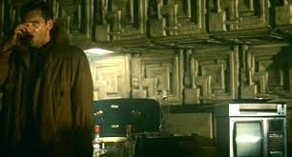
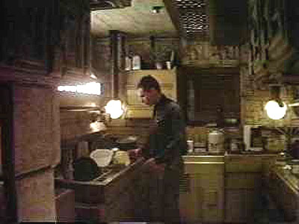

Slide 19
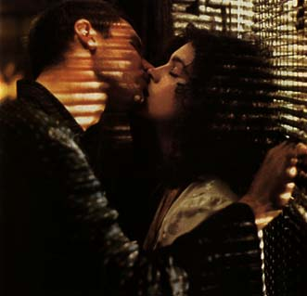

Slide 20
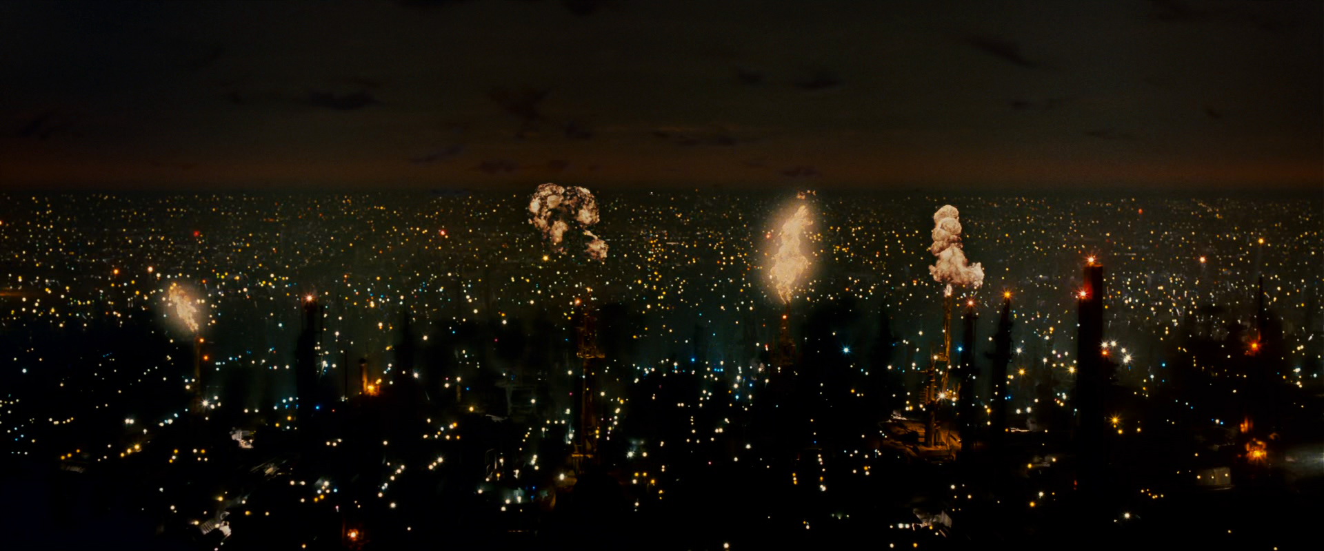

Slide 21
Opening Scene
In the opening sequence of the film Blade Runner, expressionistic lighting is used to create atmosphere and tension within a futuristic landscape.
The film opens with a panoramic shot of the cityscape revealing an industrial wasteland that is Los Angeles in the year 2019, on an Earth that is in physical and psychological decay - without a trace of nature.
The camera slowly tracks forward, showing a vast city at night where the sky is black, the city is a dirty brown colour, heavily polluted with smoke; and giant flames of exhaust gasses belch out of oil refinery towers in the industrial overgrowth. Lights twinkle from below as flying cars surge across the night sky.
The camera steadily tracks forward in rhythm to the orchestral synthesised music. An extreme close up reveals a huge, disembodied blue eye reflecting the flames above the city.

Slide 22
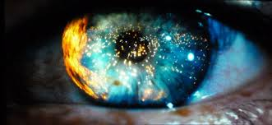

Slide 23
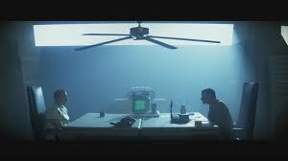
A low camera angle reveals two massive skyscraper structures shaped like an Egyptian pyramid of the gigantic Tyrell Corporation headquarters where search lights punctuate the night sky suggesting the importance of this building
When the audience is introduced to the Blade Runner Holden he is awaiting the arrival of a Tyrell Corporation new worker, Leon. The interrogation room is bathed in a blue hue suggesting a sterile and clinical environment where the Replicant test is to be administered. The use of back and side lighting, combined with the cigarette smoke from Holden, the slow turning overhead fan and the film noir parallel shadows of light cast through venetian blinds create an uncomfortable and tense atmosphere

Slide 24
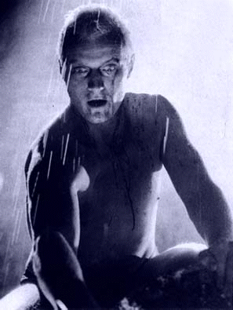
Analysing Lighting
The combination of back lighting and side lighting on Roy Batty as he attempts to save Deckard from falling reveals Roy’s empathy for Deckard and his own desire to live

Slide 25
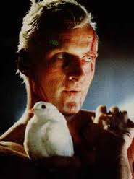
Back lighting
Under lighting
Side lighting
This combination of lighting allows the audience to feel Roy’s emotions and sympathy as he prepares to die

Slide 26
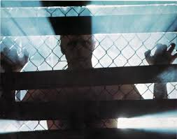
Answering the question
Break it down to 4 areas
1.The creative use of lighting is used in the
2 final scene in Blade Runner where Deckard tries to escape from the replicant.
3 Expressionistic lighting is used to show Roy Batty’s aggression and power. The use of back lighting casts Roy’s body in silhouette which makes him appear dominant as he stalks Deckard in the apartment and
4 heightens the suspense felt by the audience

